Slide 1
Learning from feedback:
An Immune cell perspective
Orchi Anannya
Ph.D. Candidate
Orchi Anannya
Ph.D. Candidate
August Lab
BBS Program

Slide 2
Basics of the Immune System
Learning objectives
  Identify the different types of immune cells
  Describe with a specific example feedback between two types of immune cells
Poll everywhere
  www.pollev.com/teachingpoll817

Slide 3

Notes:
Do not modify the notes in this section to avoid tampering with the Poll Everywhere activity.
More info at polleverywhere.com/support
Name the first three words that comes to mind when you hear the topic immune system.
https://www.polleverywhere.com/free_text_polls/IOnwhwJBG9bo69DzPpErD

Slide 4

Feedback
Attack Infected Cell
+

Slide 5
Feedback
Attack Infected Cell
+
Attack Uninfected Cell

Slide 6
Feedback
Attack Infected Cell
+
-
Attack Uninfected Cell

Slide 7
An important immune cell – the T Cells

Slide 8
T Cell
Originates in Thymus
Can be CD8 positive T cell
  kills infected cells
Can be CD4 positive T cell
  helps or regulates function of other T cells
T cell Receptor

Slide 9
T Cell
CD8
CD4 T_{H}1
CD4 T_{H}2
CD4 T_{reg}
CD8 positive T cell
CD4 positive T cell
  T Helper type 1 (T_{H}1)
  T Helper type 2 (T_{H}2)
  T regulatory cell (Treg)

Slide 10
T Cell
+
CD8 positive T cell

Slide 11
T Cell
+
CD8 positive T cell
CD4 positive T cell
  T Helper type 1 (T_{H}1)
  T Helper type 2 (T_{H}2)
+

Slide 12
T Cell
+
CD8 positive T cell
CD4 positive T cell
  T Helper type 1 (T_{H}1)
  T Helper type 2 (T_{H}2)
  T regulatory cell (Treg)
-
+
-

Slide 13
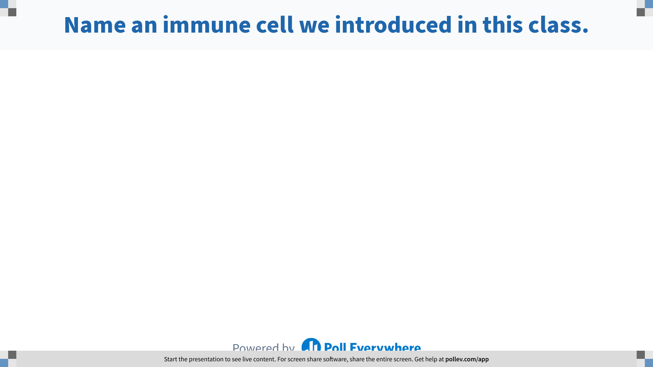
Notes:
Do not modify the notes in this section to avoid tampering with the Poll Everywhere activity.
More info at polleverywhere.com/support
Name an immune cell we introduced in this class.
https://www.polleverywhere.com/free_text_polls/wW9EnYbV4VcgNdTZG77NB

Slide 14
Many more examples being investigated………..
There is more to discover ..........
How does the CD4 or CD8 T cell know to attack the infected cell ?
CD8
or
CD4
T reg

Slide 15
Many more examples being investigated………..
There is more to discover ..........
How does the CD4 or CD8 T cell know to attack the infected cell ?
How does Treg cells know to suppress the CD4 or CD8 T cell’s function ?
CD8
or
CD4
T reg

Slide 16
Many more examples being investigated………..
There is more to discover ..........
How does the CD4 or CD8 T cell know to attack the infected cell ?
How does Treg cells know to suppress the CD4 or CD8 T cell’s function ?
Does the mechanism differ depending on type of viral or bacterial infection ?
CD8
or
CD4
T reg

Slide 17
Many more examples being investigated………..
There is more to discover ..........
How does the CD4 or CD8 T cell know to attack the infected cell ?
How does Treg cells know to suppress the CD4 or CD8 T cell’s function ?
Does the mechanism differ depending on type of viral or bacterial infection ?
What happens to the dead infected cell ?
CD8
or
CD4
T reg

Slide 18
Many more examples being investigated………..
There is more to discover ..........
How does the CD4 or CD8 T cell know to attack the infected cell ?
How does Treg cells know to suppress the CD4 or CD8 T cell’s function ?
Does the mechanism differ depending on type of viral or bacterial infection ?
What happens to the dead infected cell ?
What happens when you have the same viral or bacterial infection the second time ?
CD8
or
CD4
T reg

Slide 19
Many more examples being investigated………..
There is more to discover ..........
How does the CD4 or CD8 T cell know to attack the infected cell ?
How does Treg cells know to suppress the CD4 or CD8 T cell’s function ?
Does the mechanism differ depending on type of viral or bacterial infection ?
What happens to the dead infected cell ?
What happens when you have the same viral or bacterial infection the second time ?
Can immune cells retain memory of primary infection ?
CD8
or
CD4
T reg

Slide 20
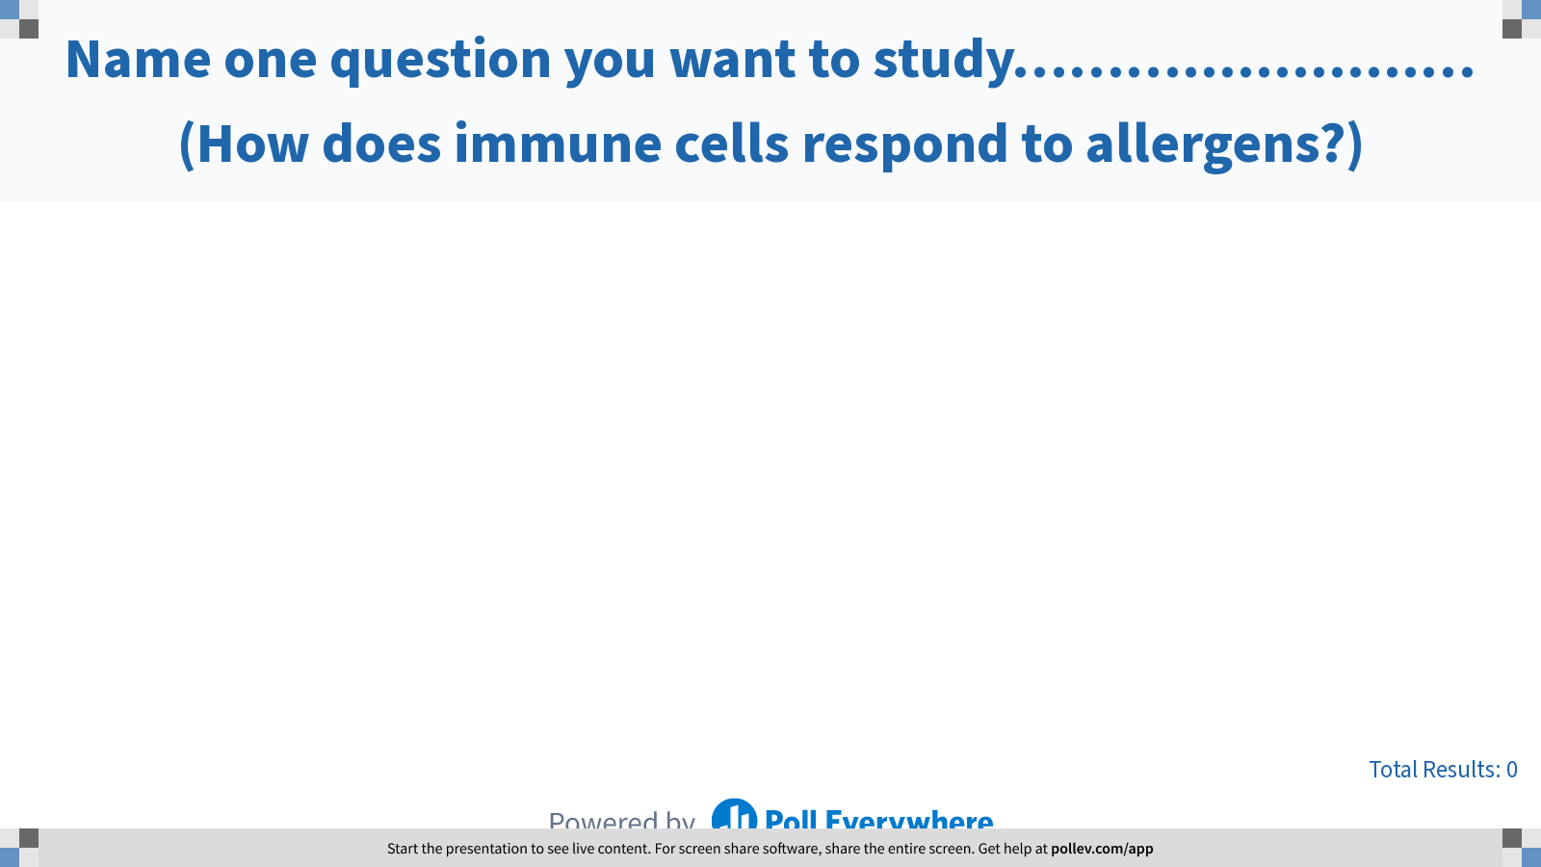
Notes:
Do not modify the notes in this section to avoid tampering with the Poll Everywhere activity.
More info at polleverywhere.com/support
Name one question you want to study……….............… (How does immune cells respond to allergens?)
https://www.polleverywhere.com/free_text_polls/tGdHPAi0HDlTtu76jxDOi

Slide 21
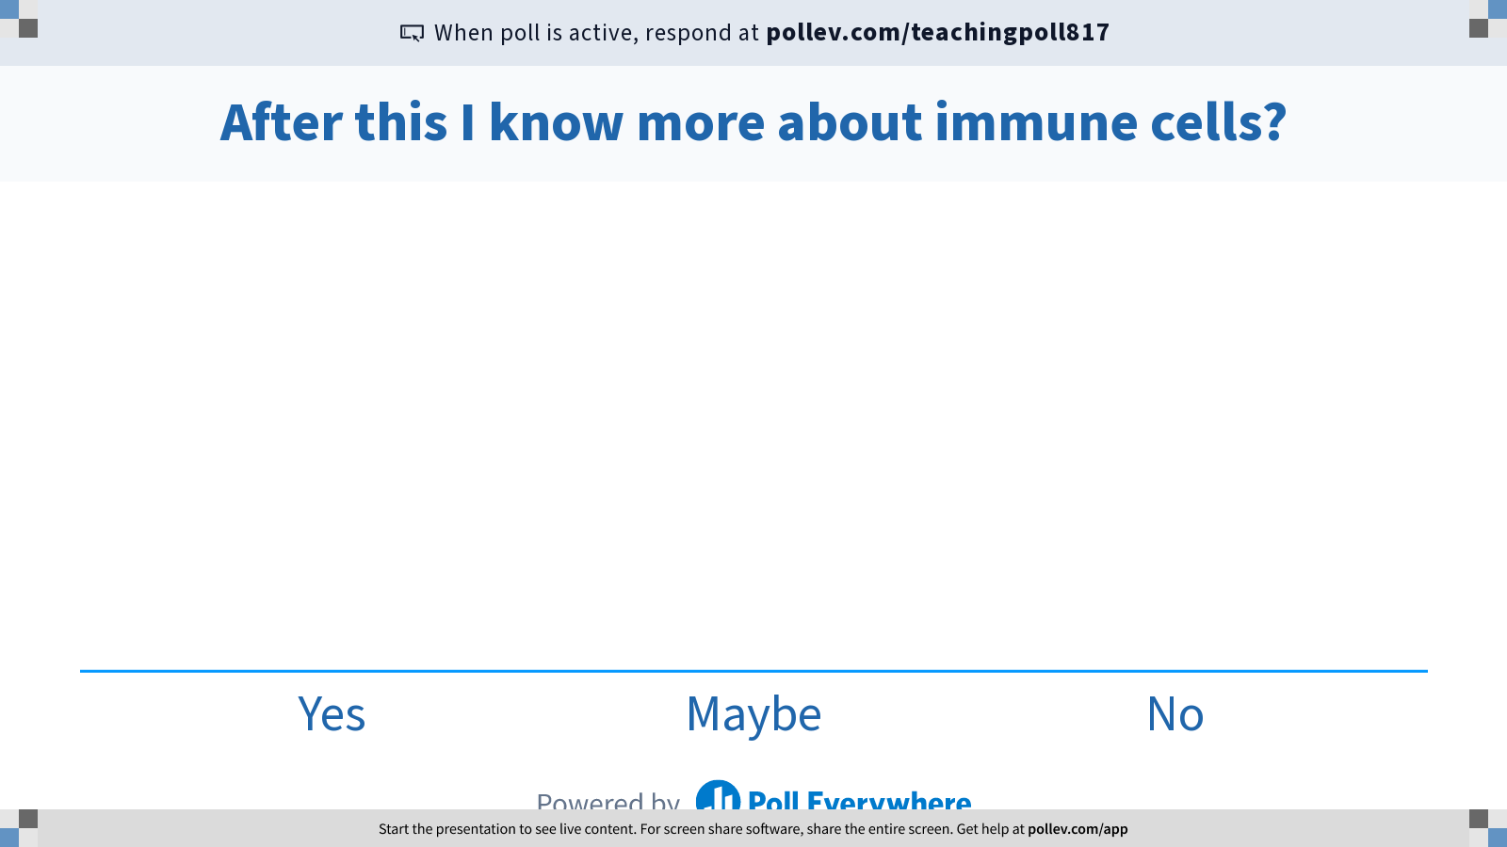
Notes:
Do not modify the notes in this section to avoid tampering with the Poll Everywhere activity.
More info at polleverywhere.com/support
After this I know more about immune cells?
https://www.polleverywhere.com/multiple_choice_polls/epORCH9Bgk1u9ygalJb7i?flow=Default&onscreen=persist

Slide 22
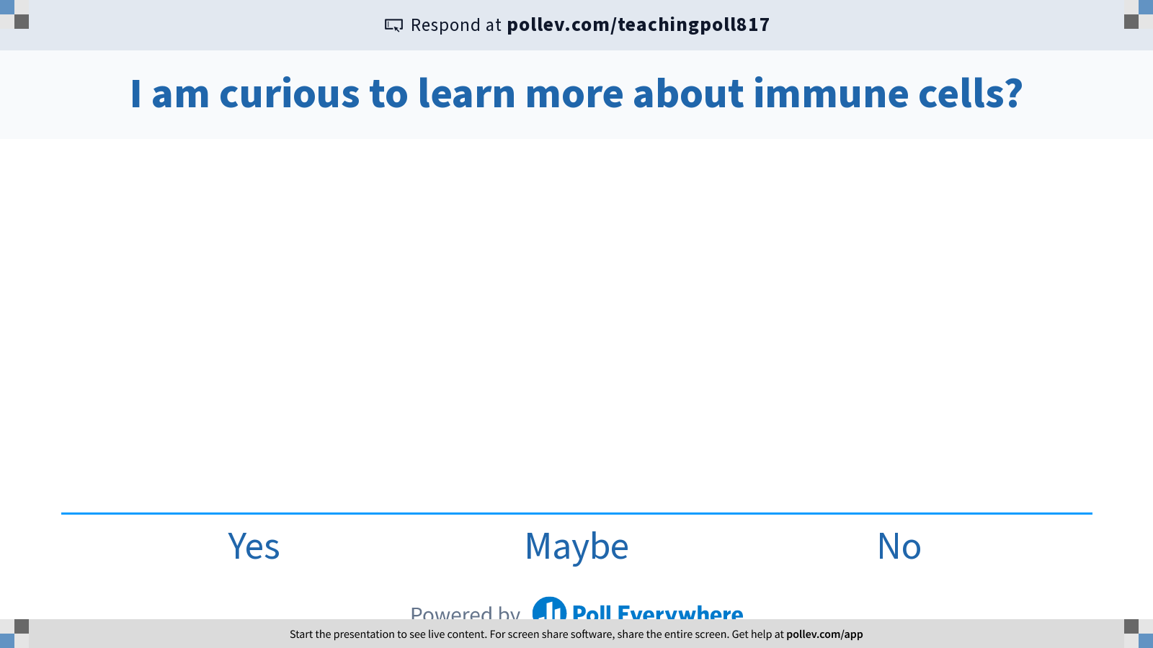
Notes:
Do not modify the notes in this section to avoid tampering with the Poll Everywhere activity.
More info at polleverywhere.com/support
I am curious to learn more about immune cells?
https://www.polleverywhere.com/multiple_choice_polls/1pPGccpBK3KOsoO8sUtrg?flow=Default&onscreen=persist

Slide 23
Thank you for your participation
Reference
Janeway’s Immunology Textbook
Janeway CA Jr, Travers P, Walport M, et al. Immunobiology: The Immune System in Health and Disease. 5th edition. New York: Garland Science; 2001.

